Slide 1

Real-Time Customer Sentiment Analysis with Amazon Web Services
Prepared by: Shaleen Swarup, Sherry Tang, Yuanzhe Wang, Zeyu Wang, Cathy Zheng
Notes:
Cathay
Hi everyone, welcome to our presentation. Our team, Shaleen, Sherry, Yuanzhe, Zeyu, and myself, Cathy, are going to talk about how you could use Amazon Web Services to construct a pipeline for real-time customer sentiment analysis.

Slide 2
Table of Contents
Business Problem Introduction
Dataset Used
AWS Services Descriptions
Pipeline
Result Demonstration
Business Values
Notes:
Cathy
We will first walk through the business problem that real-time sentiment analysis aim to resolve. We will then introduce the dataset we used, as well as the Amazon Web Services we employed. Most of our presentation will then be focus on the introduction of the analysis pipeline, after which we will show you some sample results. Finally we will wrap up the presentation by discussing the business value that implementing the pipeline could bring.

Slide 3


Business Problem
92%
Customers will stop purchasing from a company after 3 poor experiences
Manually going through reviews and comments is time consuming.
Developing and deploying in-house sentiment analysis models could be costly.
Notes:
Cathy
Did you know that 92% of customers will stop purchasing from a company after 3 poor experiences? Not only that, because we are living in a digital age when everyone is looking at their little screen all the time, information gets created, shared, and influences people at an unprecedented rate. Because of that, companies has to respond quickly to reviews, allegations, and negative information about themselves so that they don't suffer reputational and financial consequences when those kind of information gets spreaded. This is where sentiment analysis comes in. By analyzing free form texts generated by customers, companies can get a better strategize to deal with customer concern and potential public relations crisis. However, going through reviews and comments manually is going to take tremendous amount of time, and delayed responses, though better than no response at all, could still be costly to a business. The obvious solution is to develop machine learning algorithms to combat this problem. However, develop and deploy in-house models could be expensive and complicated because of the hardware requirements and the need for model training. That is why we are proposing a pipeline on Amazon web service where everything from data ingestion to sentiment analysis to summarizing and reporting is all managed and can be automated. with this pipeline, companies be confident that there public relations front is taken care of. Even better, there would be no additional hardware requirement for the implementation of this pipeline because all the services are cloud based, which also means that your data would be available for you to monitor anywhere you are.

Slide 4
Dataset Used
Product Metadata
Description
Category
Price
Brand
Images
Amazon Review Data
(233.1 million reviews in 2018 )
Review text
Ratings
Helpfulness votes
http://deepyeti.ucsd.edu/jianmo/amazon/index.html
Notes:
We used real Amazon product review data from 2018 in our pipeline. The dataset consists of product information like product description, category, price, brand of the product and images of the product and all the amazon user reviews and ratings related to the product. There are 233.1 million product reviews in the dataset.

Slide 5






AWS Services Used
Amazon S3
Amazon Athena
Object storage service that provides easy to use data management features.
Interactive query service to analyze data in Amazon S3 using standard SQL.
Amazon Lambda
Amazon Kinesis
A serverless compute service that lets you run code without provisioning or managing server.
Ingest real-time data into AWS services as it arrives and collect responses instantly.
DynamoDB
Amazon Comprehend
A key-value and document database that delivers single-digit millisecond performance at any scale.
Natural-language processing (NLP) service that uses machine learning to uncover information in unstructured data.
Notes:
We will be using the following aws services:
For storing our reviews data we will be using amazon s3. Amazon s3 is Object storage service that provides easy to use data management features.
For transferring output data to and from different services we are using amazon lambda. Amazon lamda is A serverless compute service that lets you run code without provisioning or managing servers.
We want our review data to be quickly injected into various aws services with low latency. This is the reason we are using dynamoDB in our project. DynamoDb is a key-value and document database that delivers single-digit millisecond performance at any scale.
To provide sentiment analysis on our data we are using amazon comprehend. Amazon comprehend is a Natural-language processing (NLP) service that uses machine learning to uncover information in unstructured data.
To output the data from our pipeline as and when it is generated we are using Amazon Kinesis. Amazon kinesis Ingests real-time data into AWS services as it arrives and collects responses instantly.
To showcase how effectively the real time data can be analysed we are using Amazon Athena . It provides an interactive query service for the users to do deep dive into analysis of real time data via standard sql.

Slide 6
Sentiment Analysis Pipeline
Amazon S3
Amazon Lambda
Amazon DynamoDB
DynamoDB Streams
Incoming Reviews
Amazon Athena
Amazon S3
Amazon Kinesis
Amazon Lambda
Amazon Comprehend

Slide 7
Step 1: Get Review Records and Add to DynamoDB
Lambda Function 1:
Get records from S3 using bucket and key names
Lambda Function 2:
Call function 1 to get records
Put records into DynamoDB
S3
Lambda
DynamoDB
Notes:
When there is new file uploaded to the S3, The first lambda function will read this Amazon S3 events it receives as a parameter, determines where the review object is, reads the review object, and processes the records in the review object. The second lambda function breaks the incoming record into multiple records and DynamoDB items: a review item and product item (if it doesn’t already exist). In this way it allows you to retrieve an individual item based on the partition key and sort key. If you want all the product items, you can query items based on just the product partition key.

Slide 8
Step 2: Sentiment Analysis and Send Results to DynamoDB Table
Lambda
Lambda function calls the Amazon Comprehend detect_sentiment API with the review text, and Amazon Comprehend returns one of the four sentiments: positive, negative, neutral, or mixed and calls the DynamoDB table to update the sentiment response on the review item and create product review summary items or update them if they already exist.
d_response = dt.put_item(
Item={'pk': pk, 'sk': sk + '#' + 'SENTIMENT', 'sentiment': st})
if st == "POSITIVE":
d_s_response = dt.update_item(
Key={'pk': pk,'sk': '2099-12-31#REVIEWSUMMARY'},
UpdateExpression="set positive_sentiment_count= if_not_exists(positive_sentiment_count,:start)+:inc",
ExpressionAttributeValues={':inc': 1,':start': 0},
ReturnValues="UPDATED_NEW")
Comprehend
Notes:
Next, we will use another lambda function to call amazon comprehend to do sentiment analysis for the each review text and update the result to the table in the dynamoDB

Slide 9
Step 3: Historical Analysis or Ad Hoc Queries
Update Individual record
Product Id | Date | Sentiment
Product 1 | 01-02-2019 | Positive
Product 2 | 02-03-2019 | Negative
Product 2 | 03-04-2019 | Positive
Update Summary
Product Id | Date | Positive | Neutral | Negative
Product 1 | 01-02-2019 | 1 | 0 | 0
Product 2 | 02-03-2019 | 0 | 0 | 1
1
Notes:
(click)Add the sentiment response for the review record and (click) create a product review summary record with sentiment counts.

Slide 10
Step 3: Historical Analysis or Ad Hoc Queries
DynamoDB streaming
S3 Bucket
Amazon Kinesis
Amazon Athena
Ad Hoc Queries
SELECT * FROM "amazon_review"."amazon_reviews"
where keys_pk_s ='B00004U2JW'
Notes:
After getting all the record updated on DynamoDB, the final step is to update S3 bucket. Kinesis Firehose delivery stream flatten the DynamoDB streaming JSON payload and converts the record format to Parquet and adds these records to the S3 bucket.
Then users can catalog the S3 bucket on Athena and run ad hoc queries.

Slide 11
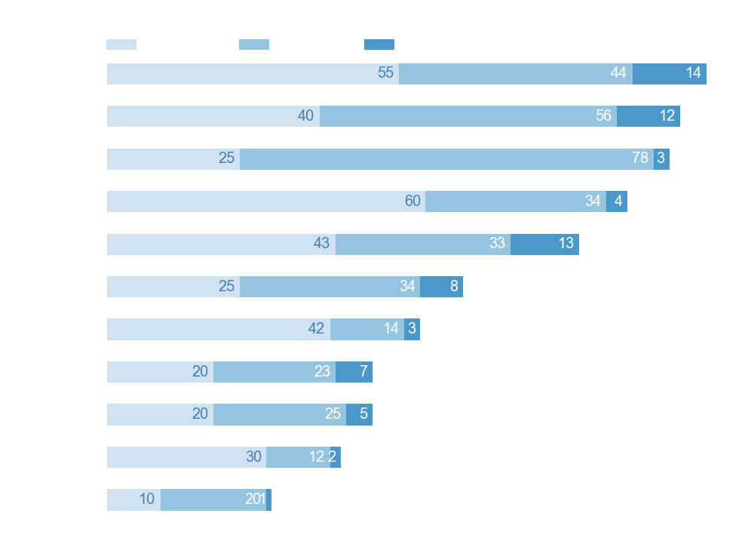
Result Demonstration
New Record
Real time Sentiment Analysis
Notes:
In summary, This application checks the sentiment on the incoming product review, creates a product review summary based on the sentiment, and keeps updates in optimized format for future ad hoc queries and analytics.

Slide 12



Business Value
92%
Customers will stop purchasing from a company after 3 poor experiences
Manually going through reviews and comments is time consuming.
Cost-effective cloud solution minimizes implementation and maintenance costs
Address customer dissatisfaction early to avoid customer churn
Save valuable time by reducing manual review effort
Developing and deploying in-house sentiment analysis models could be costly.
Notes:
Sherry
As you can see, the proposed pipeline handles everything from data ingestion to sentiment score reporting. With this real-time tool, (click) customer concerns can be addressed in a timely manner. (click) The automated nature also saves valuable time by cutting the need of repetitive manual work. Moreover, using AWS, (click) which is a cloud-based tool minimizes costs associated with hardware upgrade and ongoing maintenance. If you organization would like a fully managed solution to kick-start your sentiment analysis process and start actively managing your reputation, we think this pipeline will be an ideal

Slide 13
Thank You

Slide 14
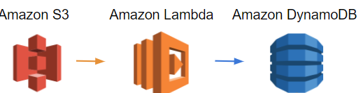
Step 1: Get Review Records and Add to DynamoDB
Lambda Function 1: Get records from S3 using bucket and key names
Lambda Function 2:
Get the S3 bucket and key for each log file contained in the event
Call function 1 to get records
Put records into DynamoDB
Notes:
The function reads the Amazon S3 events it receives as a parameter, determines where the review object is, reads the review object, and processes the records in the review object. The function breaks the incoming record into multiple records and DynamoDB items: a review item and product item (if it doesn’t already exist). This allows you to retrieve an individual item based on the partition key and sort key. If you want all the product items, you can query items based on just the product partition key.

Slide 15
Sentiment Analysis Pipeline
Amazon S3
Amazon Lambda
Amazon DynamoDB
DynamoDB Streams
Incoming Reviews
Amazon Athena
Amazon S3
Amazon Kinesis
Amazon Lambda
Amazon Comprehend

Slide 16
Step 3: Sentiment Analysis and Send Results to DynamoDB Table
Amazon Lambda
Lambda function calls the Amazon Comprehend detect_sentiment API with the review text, and Amazon Comprehend returns one of the four sentiments: positive, negative, neutral, or mixed and calls the DynamoDB table to update the sentiment response on the review item and create product review summary items (or update them if they already exist).
Amazon Comprehend
d_response = dt.put_item(
Item={'pk': pk, 'sk': sk + '#' + 'SENTIMENT', 'sentiment': st})
if st == "POSITIVE":
d_s_response = dt.update_item(
Key={'pk': pk,'sk': '2099-12-31#REVIEWSUMMARY'},
UpdateExpression="set positive_sentiment_count= if_not_exists(positive_sentiment_count,:start)+:inc",
ExpressionAttributeValues={':inc': 1,':start': 0},
ReturnValues="UPDATED_NEW")

Slide 17

Step 4: Historical Analysis or Ad Hoc Queries
Amazon Lambda
Lambda function flatten the DynamoDB streaming JSON logs and add the record to the Kinesis Data Firehose delivery stream.Invoke the Firehose delivery stream put_record API for putting updates in the S3 bucket, where you can run ad hoc queries or analytics using Amazon Athena
Amazon Kinesis
FIREHOSE_URL = os.environ['FIREHOSE_URL']
for rec in event['Records']:
if (rec['eventName'] == 'INSERT' and ('review_body' in rec['dynamodb']['NewImage'])):
convt=convert_file(rec)
response = fh.put_record(
DeliveryStreamName=FIREHOSE_URL,
...

